Slide 1
BUILDING A LEG POWER OF LEVERAGE
Do you want to make S$1,875/week FAST? OR Do you want to make S$375 cheque FASTER?

Slide 2
Strategic Numbers
150-250 BV/Month Personal Use
60 – 300 Names for “Possibility List”
Sell 100 BV (New Business) per month first 12 month in business
Show Plan to 4 qualified individuals per month

Slide 3
Reviewing and Grouping Possibilities to Build Teams
NAME (XBA)
NAME (XBA)
NAME (XBA)
NAME (XA)
NAME (XA)
NAME (XA)
NAME (XA)
NAME (X)
NAME (X)
NAME (X)
Key Groupings:
X = All Your Possibilities
A = Friends/Family
B = Colleagues

Slide 4
Reviewing and Grouping Possibilities to Build Teams
B
X
X
B
X
X
X
B
X
B
B
X
YOU
B
A
X
B
X
B
X
X
A
A
A
X
B
X
A
B
B
X
A
B
X
A
A
X
X = Your Possibilities
A = Friends/Family
B = Colleagues
A
A
A
A
A
A
A

Slide 5
Team building and placement strategy
YOU
XA
X
XA
X
XB
X
XB
Maintain vested economic interest in the success of each within the grouping they originated from on your Possibilities List
X
XA
Key Groupings:
X = All Your Possibilities
A = Friends/Family
B = Colleagues
XB
XA

Slide 6
COMBINATIONS
Team building and placement strategy
YOU
XA
X
XA
X
XB
X
XB
X
XA
Bring New Person to Follow Up
Key Groupings:
X = All Your Possibilities
A = Friends/Family
B = Colleagues
XB
XA
Home Business Presentation
Outcome: You are working two organisations in one night!

Slide 7
ABC Pattern of Duplication & Building Depth
SENIOR PARTNER
YOU
A
A
B
B
C
C
A1
A1
B1
B1
C1
C1
A2
A, B, C, etc. are Go NOW UnFranchise Owners
B2
C2

Slide 8
ASSUMPTIONS FOR CREATING THE
TEAM’S PLAN OF ACTION
Team growth based on 8:1 ratio

Slide 9
ASSUMPTIONS FOR CREATING THE TEAM’S PLAN OF ACTION
Team growth based on 8:1 ratio
Each UFO=
• 300 – 600 BV Initial • 150 – 250 BV/Month Personal Use • 100 – 600 BV/Month

Slide 10
INITIAL RETAIL SALES GOAL
MONTHLY GOAL FOR NEW UNFRANCHISE® OWNER IS TO GENERATE 200 BV AND 20 IBV FROM PERSONAL USE AND 300 BV AND 200 IBV TO A BASE OF AT LEAST 10 PREFERRED CUSTOMERS ORDERING 30 BV AND 20 IBV PER MONTH
PC -
PC -
PC -
PC -
PC -
- PC
- PC
- PC
- PC
- PC
PC = 30 BV AND 20 IBV
TOTAL UNFRANCHISE OWNER PRODUCTION: 500 BV AND 220 IBV

Slide 11
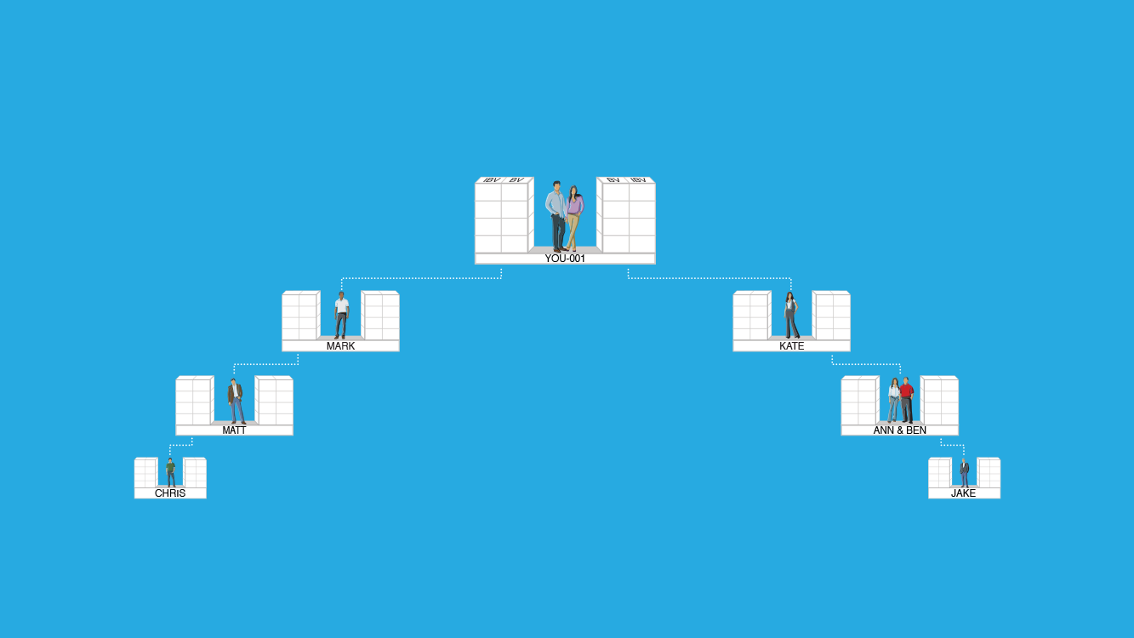
RETAIL SALES GOAL - BASE 10, SEVEN STRONG
SEVEN UFOS WITH 10 PCS EACH
Each UFO creates 500 BV and 200 IBV Monthly (Personal Use and PCs)
Commissions = S$375 Monthly (BV) and S$375 every 2nd month (IBV)
1500 BV & 600 IBV
1500 BV & 600 IBV
5 PCs
5 PCs
500 BV & 200 IBV Volume can be placed
5 PCs
5 PCs
5 PCs
5 PCs
500 BV & 200 IBV
500 BV & 200 IBV
5 PCs
5 PCs
5 PCs
5 PCs
500 BV & 200 IBV
500 BV & 200 IBV
5 PCs
5 PCs
5 PCs
5 PCs
500 BV & 200 IBV
500 BV & 200 IBV
BV and IBV banks on this slide display weekly volume accruals

Slide 12
Minimum Activity
50 BV and 10 IBV monthly per UFO
Power of Your Actions
Monthly Goal and Base 10
200 BV and 20 IBV monthly per UFO Preferred Customers per UFO (30/20 each)
Shopping Annuity® and Base 10
500 BV and 200 IBV monthly per UFO
300 BV and 200 IBV to 10 Preferred Customers per UFO (30/20 each)

Slide 13
ORGANISATION SATISFYING THE MINIMUM ACTIVITY REQUIREMENTS
Commissions = S$750 monthly (BV) and S$375 every quarter (IBV)
Minimum Activity Requirements 50 BV + 10 IBV monthly per UFO Total = 50 BV + 10 IBV per UFO
You should earn S$375-S$750 every two weeks (BV) and S$375 quarterly (IBV)
50 UFO’s x 50 BV = 2,500 BV Monthly
50 UFO’s x 10 IBV = 500 IBV Monthly
50 UFO’s x 10 IBV = 500 IBV Monthly
50 UFO’s x 50 BV = 2,500 BV Monthly
BV and IBV banks on this slide display weekly volume accruals

Slide 14
ORGANISATION SATISFYING THE MONTHLY GOAL AND BASE 10
Commissions = S$7,500 monthly (BV) and S$3,750 monthly (IBV)
Monthly Goal 200 BV + 20 IBV monthly per UFO Base 10
300 BV + 200 IBV from 10 PCs per UFO Total = 500 BV + 220 IBV per UFO
You should earn S$1,875 weekly (BV) and S$1,875 every 2 weeks (IBV)
50 UFO’s x 500 BV = 25,000 BV Monthly
50 UFO’s x 200 IBV = 10,000 IBV Monthly
50 UFO’s x 200 IBV = 10,000 IBV Monthly
50 UFO’s x 500 BV = 25,000 BV Monthly
BV and IBV banks on this slide display weekly volume accruals

Slide 15
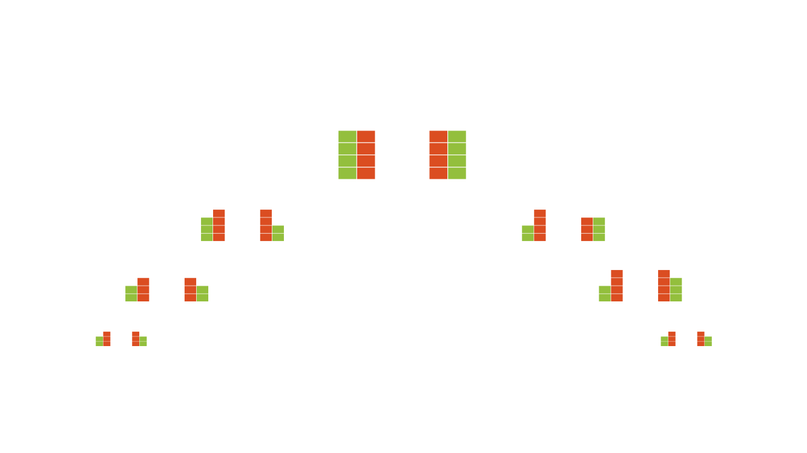
ORGANISATION SATISFYING THE SHOPPING ANNUITY®
AND BASE 10
Shopping Annuity 500 BV + 200 IBV monthly per UFO Base 10 300 BV + 200 IBV from 10 PCs per UFO Total = 800 BV + 400 IBV per UFO
You should earn S$2,625 weekly (BV) and S$1,875 weekly (IBV)
50 UFO’s x 800 BV = 40,000 BV Monthly
50 UFO’s x 400 IBV = 20,000 IBV Monthly
50 UFO’s x 400 IBV = 20,000 IBV Monthly
50 UFO’s x 800 BV = 40,000 BV Monthly
BV and IBV banks on this slide display weekly volume accruals

Slide 16
Minimum Activity
Power of Your Actions
S$875 average monthly commission
Monthly Goal and Base 10
S$11,250 average monthly commissions
Shopping Annuity and Base 10
S$18,000 average monthly commissions

Slide 17
Power of Your Actions
Minimum Activity
Minimum Activity
50 BV and 10 IBV monthly per UFO
S$875 average monthly commissions
Monthly Goal and Base 10
Monthly Goal and Base 10
200 BV and 20 IBV monthly per UFO
300 BV and 200 IBV to 10 Preferred Customers per month
S$11,250 average monthly commissions
Shopping Annuity® and Base 10
Shopping Annuity® and Base 10
500 BV and 200 IBV monthly per UFO
300 BV and 200 IBV to 10 Preferred Customers per UFO (30/20 each)
S$18,000 average monthly commissions

Slide 18
Achieve your goals
By solely relying on your efforts and results
OR
By building two (2) teams of UnFranchise® Owners

Slide 19
YOU NEED TO TAKE FULL RESPONSIBILITY FOR YOUR OWN SUCCESS.
THIS IS YOUR BUSINESS AND YOUR INCOME!

Slide 20
YOU CAN’T PUT YOUR MA UNFRANCHISE BUSINESS 2ND, 3RD OR 4TH ON THE PRIORITY LIST AND EXPECT IT TO PAY YOU 1ST!!

Slide 21
THE EVOLUTION OF A LEADER

Slide 22
The higher level of leadership… the greater the effectiveness
Leadership develops daily, not in a day
Collection of skills over time
It has many faces:
Respect
Experience
Emotional Strength
Timing
People Skills
Discipline
Vision
Momentum
LEADERSHIP
The first person you must lead, IS YOU!

Slide 23
UFO – EXECUTIVE COORDINATOR (EC) Position (Right)
EC – PROFESSIONAL COORDINATOR (PC)
Permission (Relationships)
PC – NATIONAL SUPERVISING COORDINATOR (NSC)
Production (Results)
NSC – DIRECTOR AND HIGHER
People Development (Reproduction)
EVOLUTION OF A UFO LEADER

Slide 24
UFO – EXECUTIVE COORDINATOR (EC) Position (RIGHT)
People follow you because they feel they have to
Can not extend influence beyond title
Get into territorial rights
Into tradition, organisational charts
*These habits are not negative unless they become only basis for authority

Slide 25
UFO – EXECUTIVE COORDINATOR (EC) Position (RIGHT)
Leadership is based on TITLE not TALENT
Have difficulty working with volunteers
Volunteers… no monetary leverage
White collar… want to participate in decision
Younger people… unimpressed with symbols
CAUTION! Longer you stay here the lower the morale and the higher the turnover…

Slide 26
UFO – EXECUTIVE COORDINATOR (EC) Position (RIGHT)
Characteristics that must be exhibited with excellence to advance
Know your job description thoroughly
Know the history of organisation
Be a team player
Accept responsibility
Do your job with consistent excellence
Do more than expected

Slide 27
EC – PROFESSIONAL COORDINATOR (PC) Permission (Relationships)
People follow you because they want to
Allows you to influence beyond title
People work with you when they are not obligated
Donates time, energy and focus on follower’s needs
You can love people without leading them, But you can not lead people without loving them
CAUTION! Staying too long at this level without rising will cause your highly motivated people to become restless

Slide 28
EC – PROFESSIONAL COORDINATOR (PC) Permission (Relationships)
Pareto Principle: 20/80 Rule
Identify which are the top 20% producers
Identify what top 20% of activities generate 80% of results
80% of your “people time” with the top 20%
20% will generate 80% of organisation’s success

Slide 29
EC – PROFESSIONAL COORDINATOR (PC) Permission (Relationships)
Characteristic’s that must be mastered on this level to advance
Possess a genuine love for people
Make those who work with you more successful
See through other peoples eyes
Do “win-win” or don’t do it at all
Include others in your journey
Deal wisely with difficult people

Slide 30
PC – NATIONAL SUPERVISING COORDINATOR (NSC)
Production (Results)
People follow you because of what you have done for the organization
Good things are happening; Profit increases, Morale is high, Turnover is low, Needs are being met and Goals are being reached
Accompanying this growth is the “Big MO” – Momentum
Problems get solved with little effort
People like to get together for a purpose

Slide 31
PC – NATIONAL SUPERVISING COORDINATOR (NSC)
Production (Results)
Characteristics that must be mastered on this level to advance
Initiate and accept responsibility for growth
Develop and follow a statement of purpose
Develop accountability for results, beginning with yourself
Know and do the things that give a high return
Communicate the strategy and vision of the organisation

Slide 32
NSC – DIRECTOR AND HIGHER
PEOPLE DEVELOPMENT (Reproduction)
People follow you because of what you have done for them Leader is highly effective because of their ability to empower other
Your commitment to developing leaders insures long-term growth for organisation for people and residual income

Slide 33
NSC – DIRECTOR AND HIGHER
PEOPLE DEVELOPMENT (Reproduction)
CAUTION! New people may view you as a “Position” leader because you have had no contact with them
Walk slowly through the crowd… find ways to touch with everyone
Continue to teach and train the 20 Percenters

Slide 34
NSC – DIRECTOR AND HIGHER
PEOPLE DEVELOPMENT (Reproduction)
Characteristics that must be mastered on this level to advance
Realise people are your most valuable asset
Priority is to develop people
Be a model for others to follow

Slide 35
NSC – DIRECTOR AND HIGHER
PEOPLE DEVELOPMENT (Reproduction)
Pareto Principle 20/80 Rule
Attract other winners/producers to the common goal

Slide 36
AND WITH TIME: PERSONHOOD
(RESPECT)
People follow you because of who you are and what you represent
Only a lifetime of proven leadership will allow us to sit at this level
Level is reserved for leaders who have spent years growing people and organisations
It is bestowed by the people

Slide 37
AND WITH TIME: PERSONHOOD
(RESPECT)
Characteristics that define this level of Leadership
You never squander an opportunity to LEAD at the base level
Your followers are loyal and sacrificial
You have become a statesman/consultant and are sought out by others
Greatest joy comes from watching others grow and develop
You transcend the organisation

Slide 38
The higher you go, the longer it takes
The higher you go, the higher the level of commitment
The higher you go, the easier it is to lead
The higher you go, the greater the growth
You never leave the base level
For your leadership to remain effective, it is essential that you take other influencers with you to higher levels
You must know what level you are on at this moment
INSIGHTS ON THE LEADERSHIP

Slide 39
Do your job with consistent excellence!
Implementing the 20/80 Rule is the Rule!
Don’t let GO of “BIG MO!”
Know and do things that give high return!
Realise people are your most valuable resource – EMPOWER!
MY BASIC 5 OF BEING A LEADER

